Slide 1
Data Science: Big Data Management Systems & Tools
Module 3: NoSQL

Slide 2
Module 3 Summary
Beyond relational database management systems
Learning Outcomes
Explore different paradigms of modelling real world data,
Understand the benefits and challenges of storing data using different type of data stores,
Determine which stores are best suited for certain applications,
Become familiar with the basics of MongoDB, and
Perform basic operations in MongoDB.

Slide 3
Current data needs exceed just SQL (NoSQL)
Traditional RDBMS were just too slow to handle the expectations of today’s user
NoSQL is a broad term to describe a database system that is, generally speaking:
Non-Relational
Schemaless (does not require a fixed structure to be defined before any data can be loaded)
Horizontally Scalable (designed for parallel processing of large loads using potentially many servers)
Does not support full SQL
Loosely adheres to ACID properties or not at all
Notes:
Last week, we spoke about SQL databases and why they are slows due to its prioritization of integrity. The checks needed to maintain integrity can take time. NoSQL on the other hand, gives you the low latency setup needed from many of today’s application.
Scalability: SQL databases often struggle to scale horizontally across multiple servers, especially when dealing with huge amounts of data. NoSQL databases, on the other hand, are designed to scale easily and handle large volumes of data by distributing data across many servers.
Flexibility: Traditional relational databases impose a rigid schema, requiring data to be structured in tables with predefined schemas. NoSQL databases offer more flexibility, allowing for schema-less or schema-less approaches, which is particularly useful for applications dealing with constantly changing data formats or where the data structure is not well-defined in advance.
Give example about having to take a database offline in order to add and backfill a column
Performance: NoSQL databases are often optimized for specific use cases, offering better performance for tasks like real-time analytics, high-speed transactions, and content management systems.
Big Data: With the advent of big data, traditional relational databases struggled to efficiently handle the massive volumes of data generated by modern applications, social media platforms, IoT devices, etc. NoSQL databases provide better support for handling big data workloads.
Distribution: NoSQL databases are designed to work well in distributed environments, where data is spread across multiple servers or data centers. This makes them suitable for applications requiring high availability and fault tolerance.

Slide 4


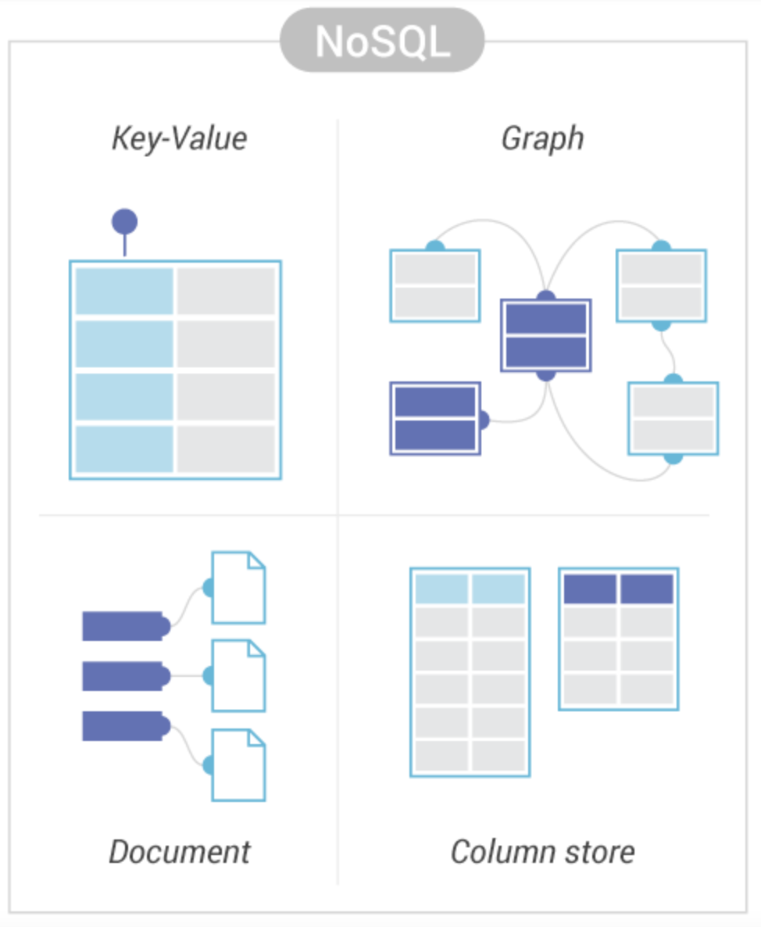


Popular NoSQL datastore types
Simple key-value method to store data. Used for user session data
Store and navigate relationships. Used for recommendation apps.
Stores data in JSON docs. Used for content management apps like blogs
Stored in columns instead of rows. Used for IoT device data
Notes:
Key-Value NoSQL Databases
Description: Key-Value databases store data as a collection of key-value pairs, where a unique key is used to identify a value. This model is simple and allows for fast retrieval of data.
Examples: Redis, Memcached
Graph Databases
Description: Graph databases store data in nodes (entities) and edges (relationships). This structure is optimized for querying and traversing complex relationships and interconnections between data points.
Examples: Neo4j, Amazon Neptune
Document Databases
Description: Document databases store data as documents, typically in JSON, BSON, or XML format. Each document is a self-contained unit of data, which can include nested structures and arrays, allowing for flexible and semi-structured data storage.
Examples: MongoDB, CouchDB
Column Store Databases
Description: Column store databases store data in columns rather than rows, which makes them highly efficient for read-heavy operations and analytical queries. Each column is stored separately, allowing for better compression and faster access to individual columns.
Examples: Apache Cassandra, HBase
These descriptions should help clarify the basic concepts and typical use cases for each type of NoSQL database.

Slide 5
Use cases for each type of datastore
Datastore Type | Use Case
Relational | Transactional, Reporting Applications
Column Based | Analytics Applications
Graph | Recommendation Applications
Document | Content management (blogs, catalogs) applications

Slide 6
Pros and cons of each type of datastore
Database Type | Advantages | Disadvantages
Relational | Consistency, Security | Flexibility
Column Based | Scalability | Transactional analysis capability
Graph | Flexibility | Standardization, Only useful for graph modeling
Document | Agile | Consistency, Security

Slide 7
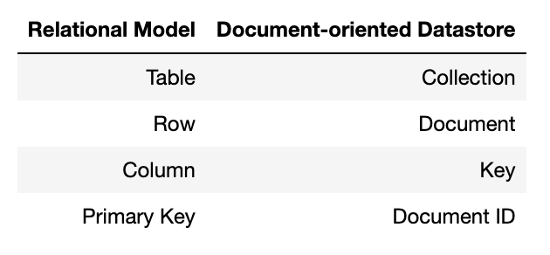
Document storage vs relational model

Slide 8
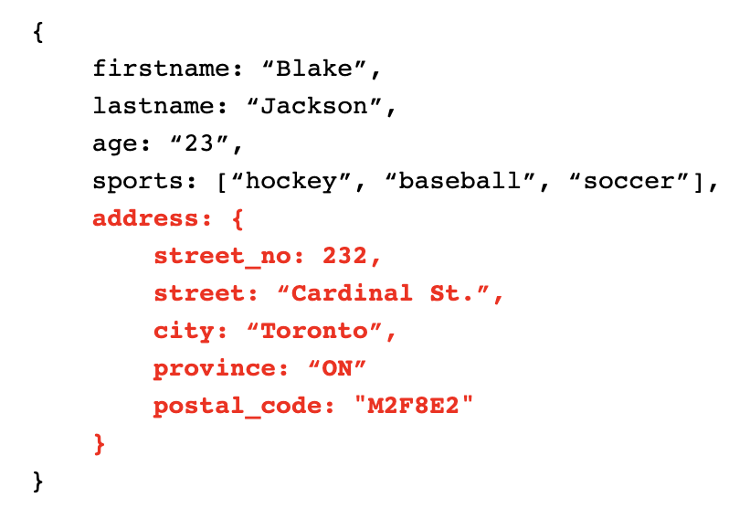
Document storage
One of the major types of NoSQL databases (Very fast retrieval)
A semi-structured data storage such as XML, JSON
Most document-oriented databases can use the key/value pairs in JSON
Document-oriented databases organize documents in collections
Documented-oriented datastores are designed to scale
Notes:
Give an example of what this would look like in a tabular format

Slide 9
JavaScript Object Notation (JSON)
JavaScript Object Notation
Open standard
Human-readable text file format
Consists of key-value pairs
Lightweight
Language independent
Used for storage and transmission of data objects

Slide 10
Intro to MongoDB
Open source
Multi-platform (Linux, Windows, MacOS)
JavaScript based
Built on platforms with redundancy (high availability)
Uses "shards" to split up database (Horizontal Scalability)

Slide 11
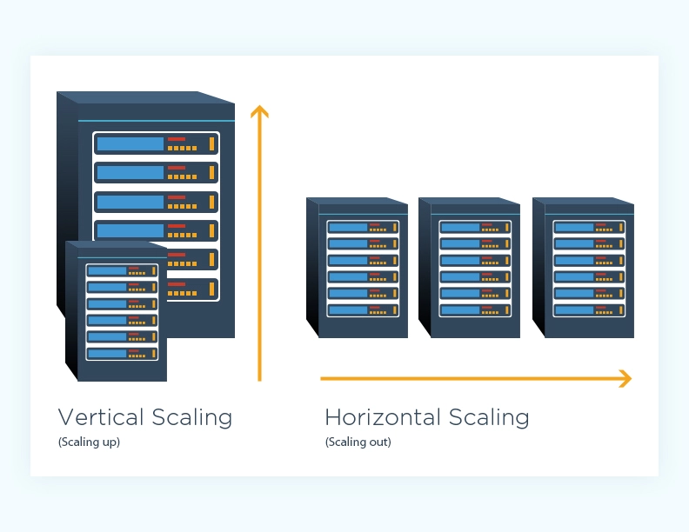
Scaling horizontally or vertically
The first way to address poor relational database performance is to use a faster server with more memory and/or CPUs (Scaling up or vertical scaling)
BUT, once you have the biggest and fastest server on the market, continuing to scale up is no longer an option
A more general solution is to scale out (horizontal scaling) by adding additional servers to create a cluster to distribute the data and load over
However, when we distribute data over several servers, the ACID properties become extremely difficult to maintain

Slide 12
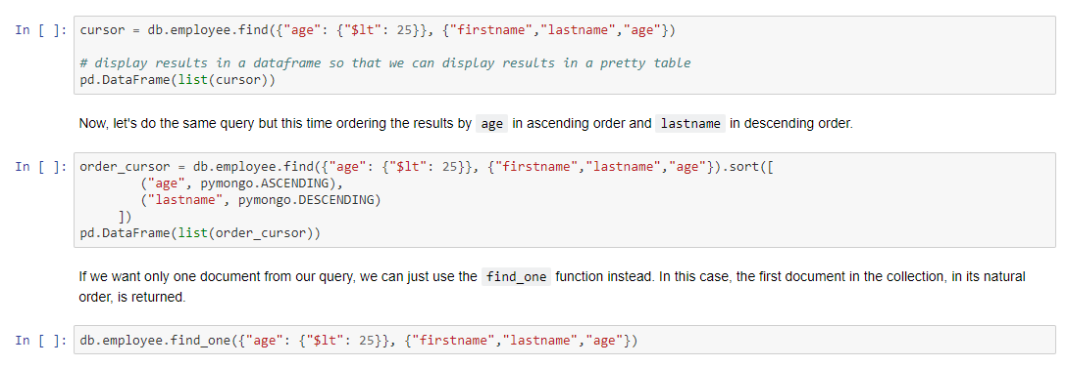
Querying a collection
find_one: Returns the first document in the collection.
find: Returns a cursor that represents the list of matching documents based a query.

Slide 13
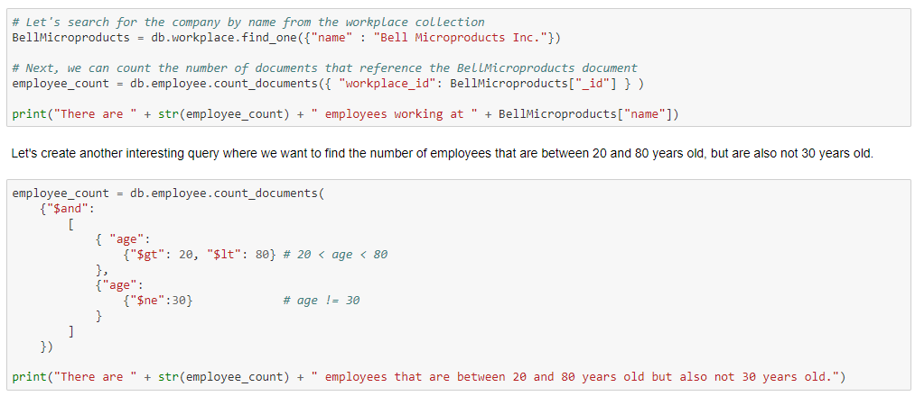
Counting documents
count_documents()

Slide 14
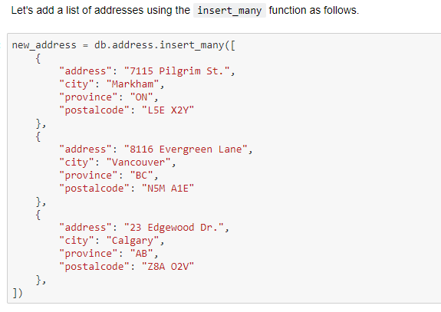
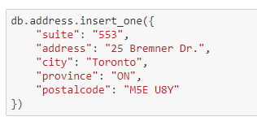
Insert documents
insert_one: Inserts only one document into a collection.
insert_many: Inserts a list of documents into a collection.

Slide 15
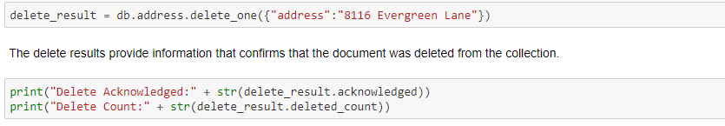
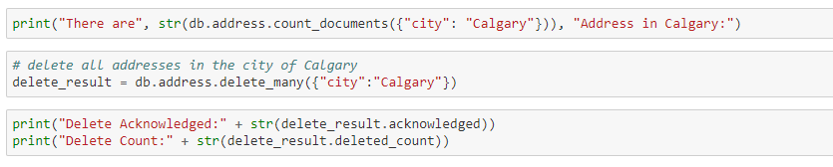
Deleting documents
delete_one: Deletes one document from a collection.
delete_many: Deletes a list of documents from a collection.

Slide 16
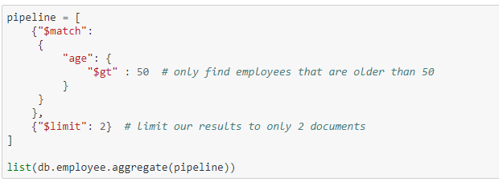
Aggregate query
A pipeline is made of stages. At each stage, the data undergoes a transformation that ends with the computed result.

Slide 17
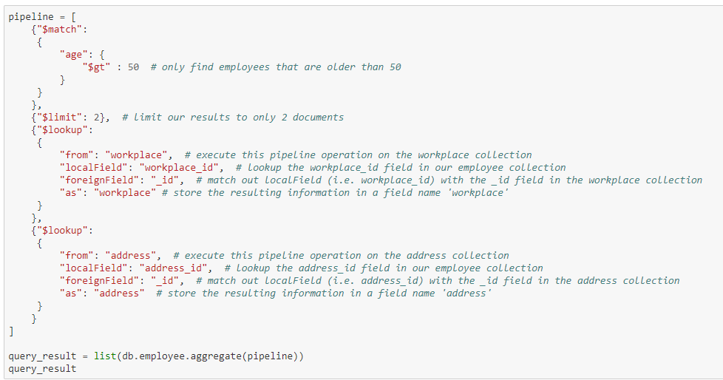
“joining” collections
$lookup function

Slide 18
When to use which datastore
When deciding on a datastore for your application, ask yourself the following questions:
Is the data structured, semi-structured, or unstructured?
Is the data a table? Voice messages? Log data?
Which model best describes your data?
Does your data look like table? Social network?
What is your availability and consistency model?
Does the data consistency (bank accounts) matter for the user, or does availability (facebook posts) matter for the user?

Slide 19



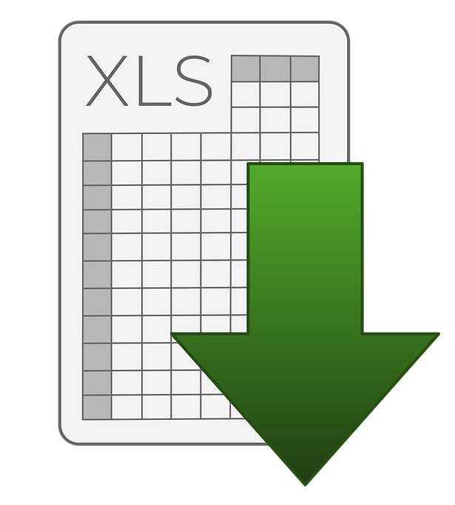
Why is this important?
Data comes in various shapes and sizes, and no one solution fits all
Applications are increasingly depended on storing and retrieving data

